Slide 1
Deep Learning
History of Deep Learning
Prabu P,Christ University,Bangalore

Slide 2
Road Map
Deep Learning Vs Machine Learning Vs Artificial Intelligence Vs Data Science
History of Deep Learning

Slide 3
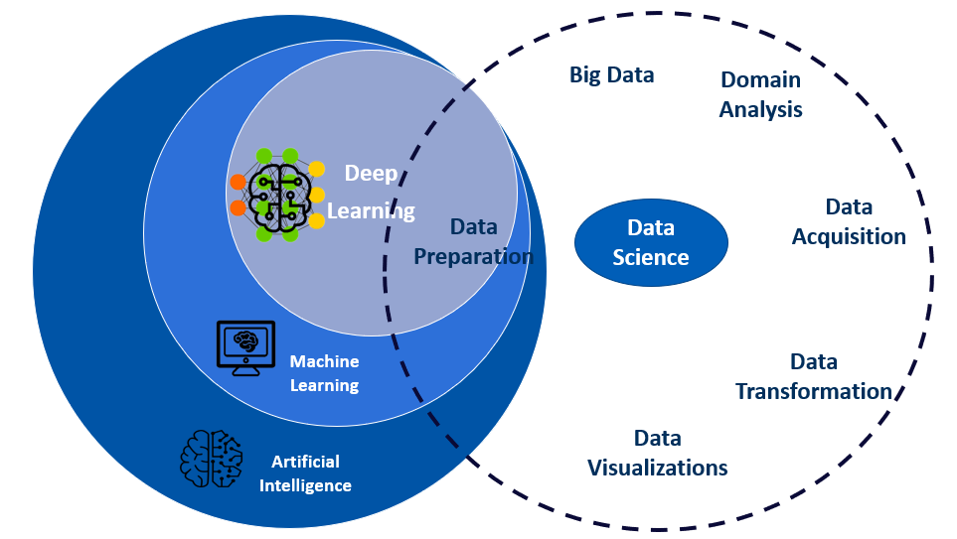
Deep Learning Vs ML Vs AI Vs Data Science
Artificial Intelligence is regarded as a field of study to provide intelligent capabilities to machines to the extent that it either mimics human intelligence or betters it
Machine learning is a process in which the trained model (after learning from the historical data) starts making human-like decisions

Slide 4
Deep Learning Vs ML Vs AI Vs Data Science
Deep learning is a subfield of machine learning that structures algorithms in layers to create an "artificial neural network” that can learn and make intelligent decisions on its own
DL uses neural network models to understand a large amount of data
DL is the preferred choice when -
The data has too many features
The data is huge in size
Extremely high level of accuracy is required

Slide 5
Deep Learning Vs ML Vs AI Vs Data Science
Data Science is all about data.
It’s a multidisciplinary field focused on drawing INSIGHTS that can help an organization make better decisions

Slide 6
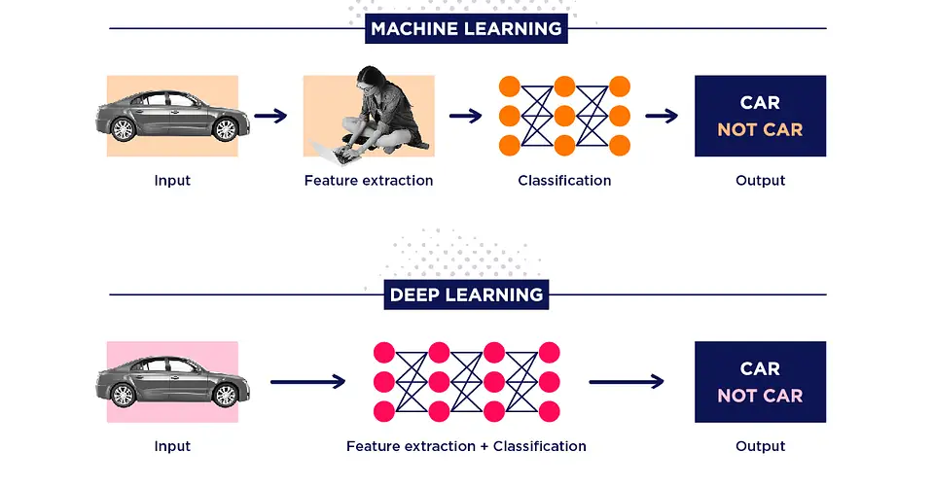
Deep Learning Vs ML Vs AI Vs Data Science

Slide 7
Neural Networks are taking over!
Neural networks have become one of the main
approaches to AI:
They have been successfully applied to various pattern recognition, prediction, and analysis problems
In many problems they have established the state of the art– Often exceeding previous benchmarks by large margins
Sometimes solving problems you couldn’t solve using earlier ML methods

Slide 8

Breakthroughs with neural network

Slide 9

Breakthroughs with neural network

Slide 10

Breakthroughs with neural network

Slide 11
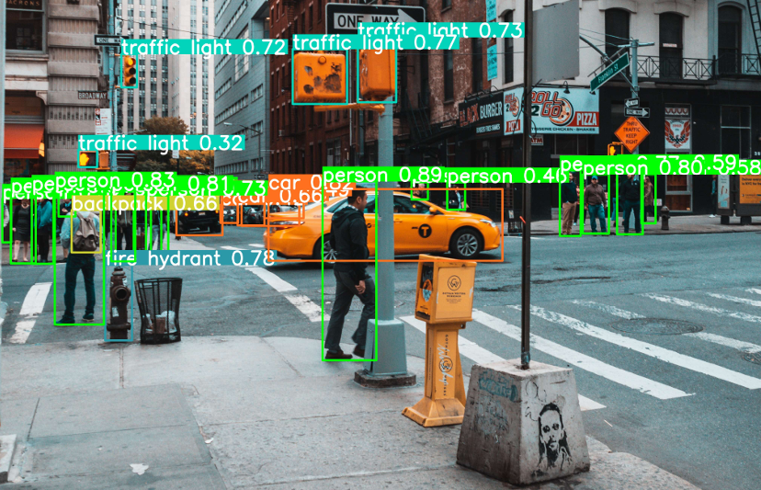
Breakthroughs with neural network

Slide 12

Breakthroughs with neural network

Slide 13
Successes with neural networks
And a variety of other problems:
From art to astronomy to healthcare..
and even predicting stock markets

Slide 14
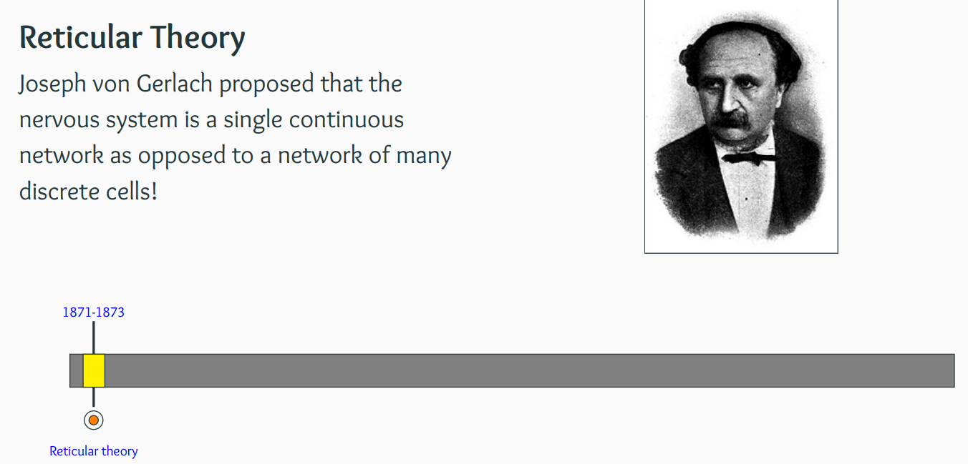
History of Deep Learning – Biological Neuron

Slide 15
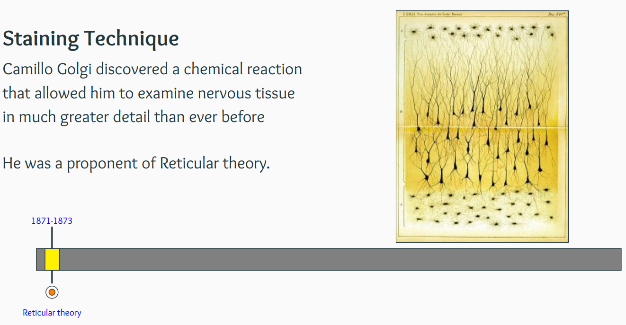
History of Deep Learning – Biological Neuron

Slide 16
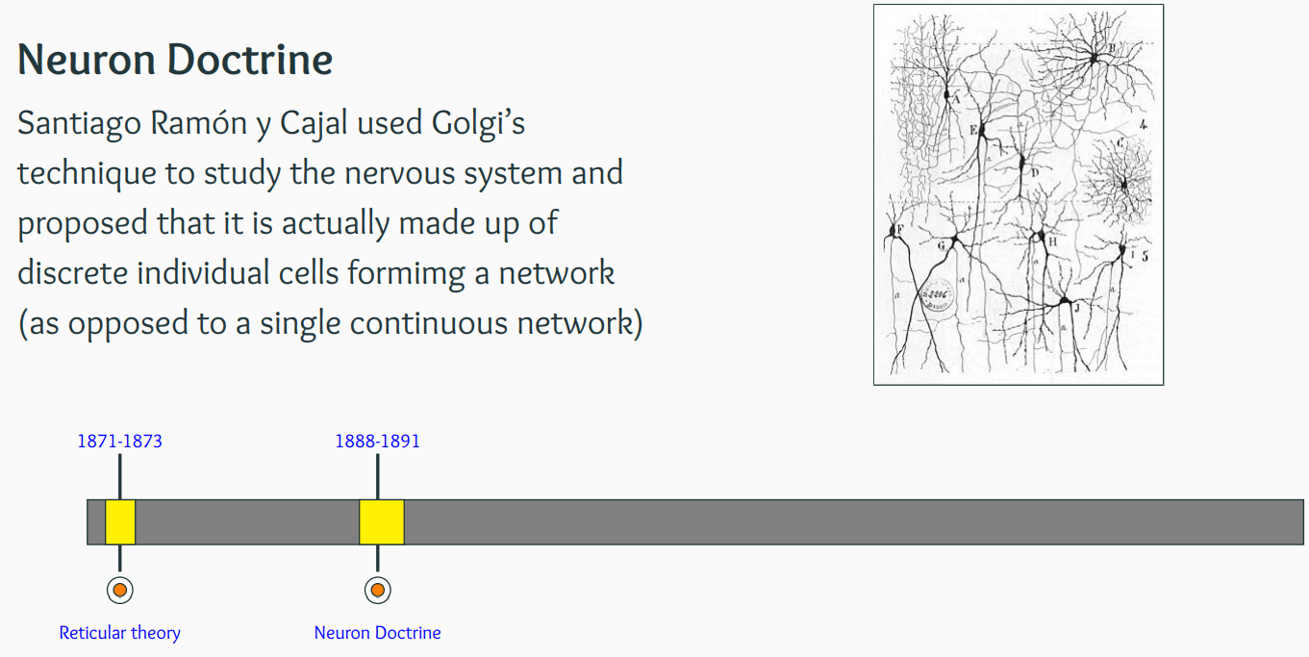
History of Deep Learning – Biological Neuron

Slide 17
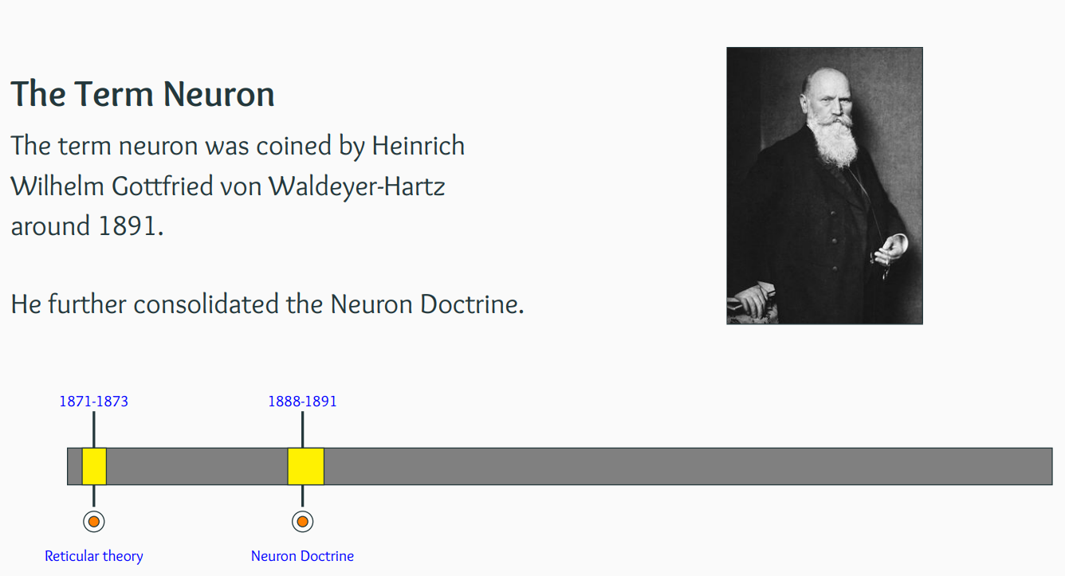
History of Deep Learning – Biological Neuron
Chromosome

Slide 18
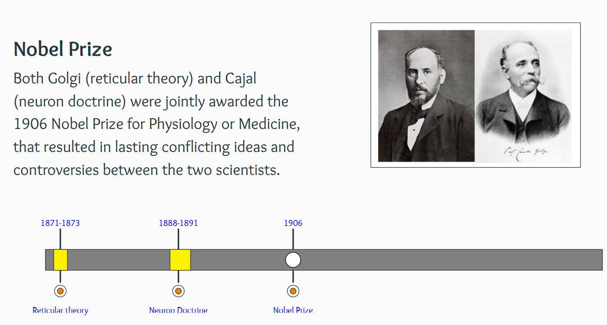
History of Deep Learning – Biological Neuron

Slide 19
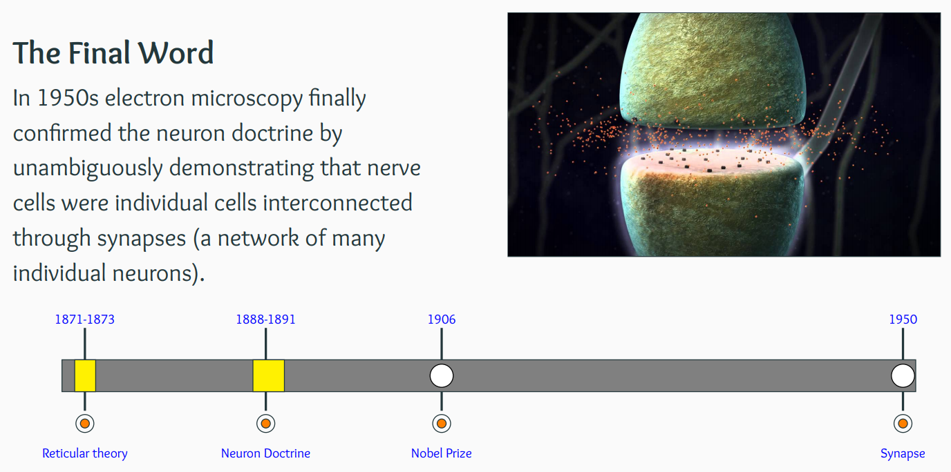
History of Deep Learning – Biological Neuron

Slide 20
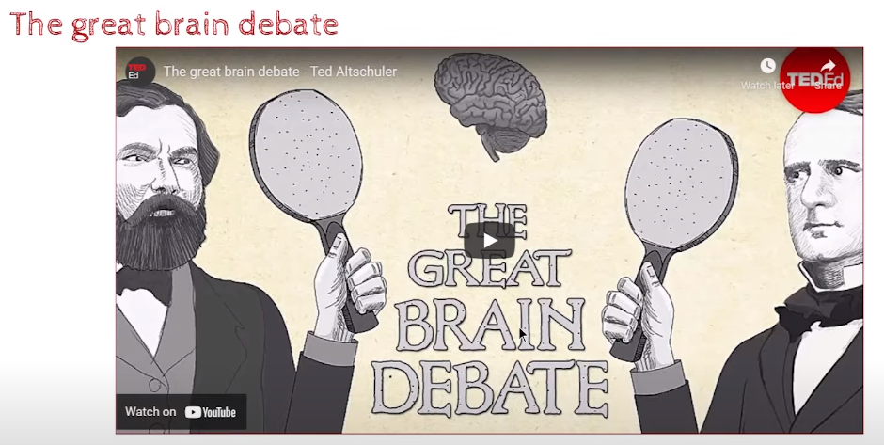
History of Deep Learning – Biological Neuron

Slide 21
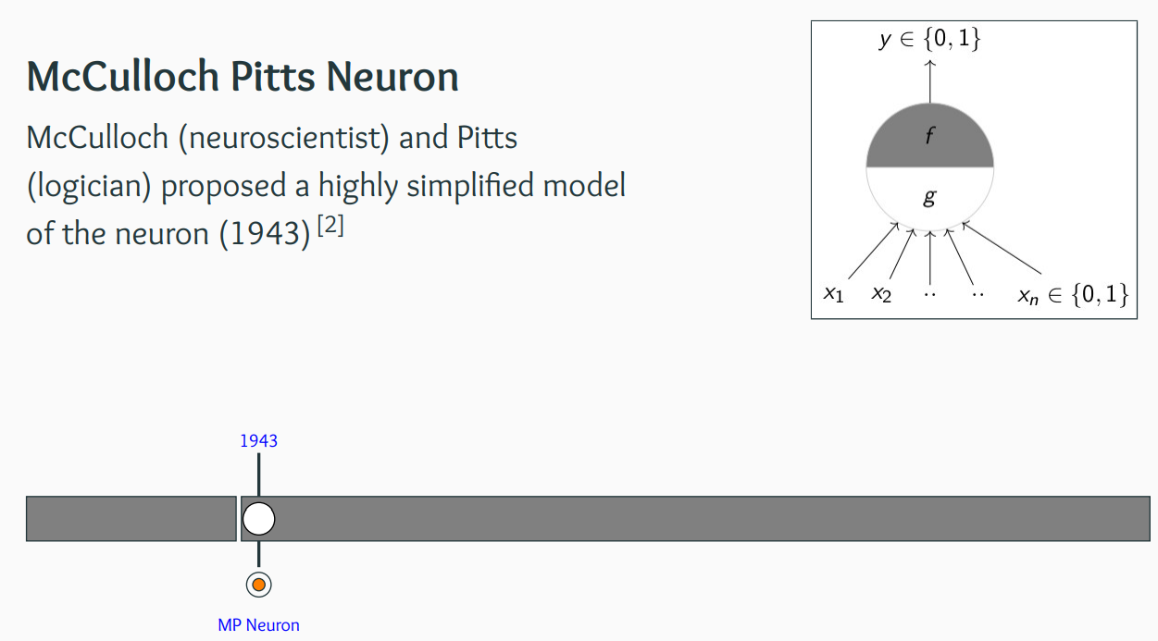
Biological Neuron to Artificial Neuron

Slide 22
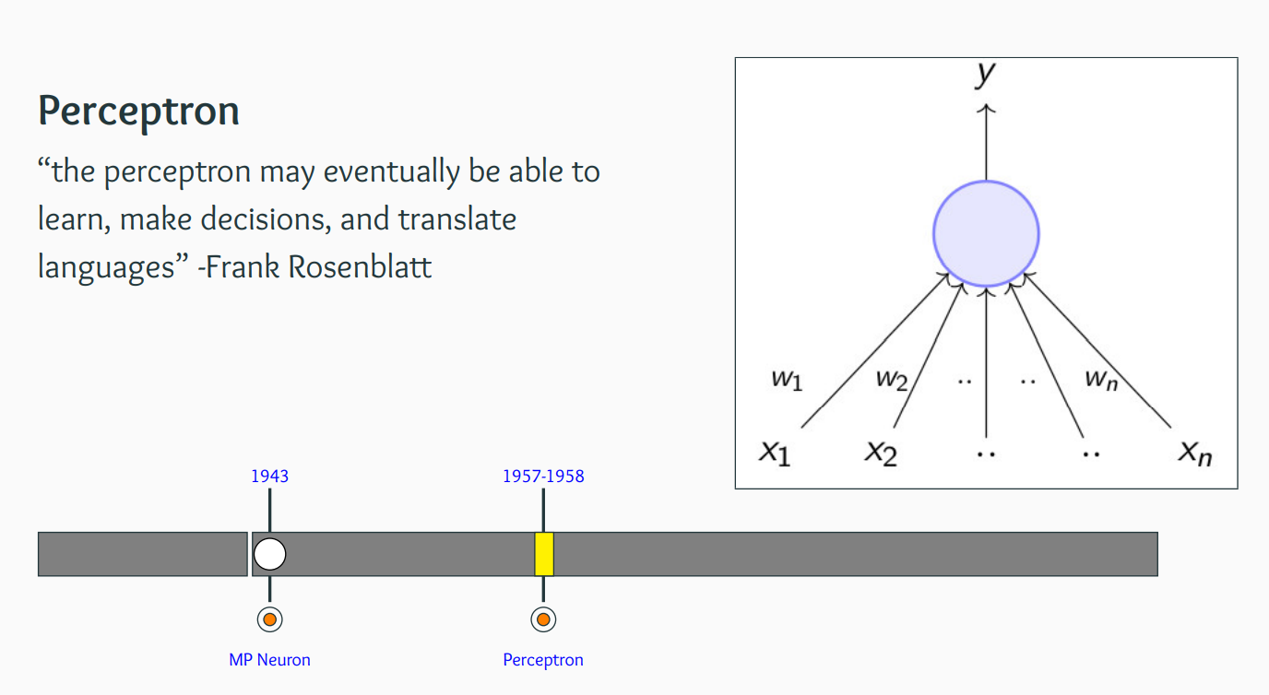
Biological Neuron to Artificial Neuron

Slide 23
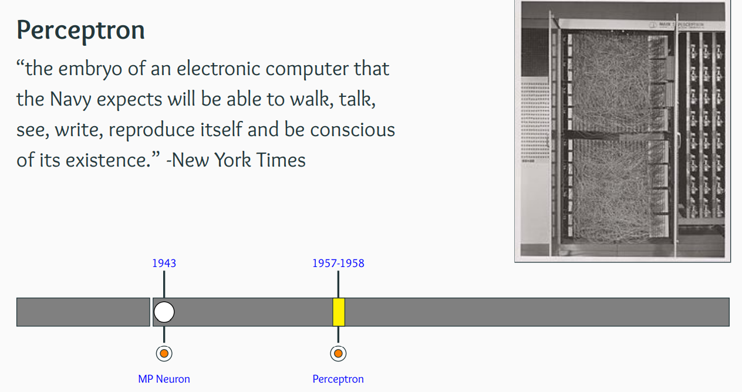
Biological Neuron to Artificial Neuron

Slide 24
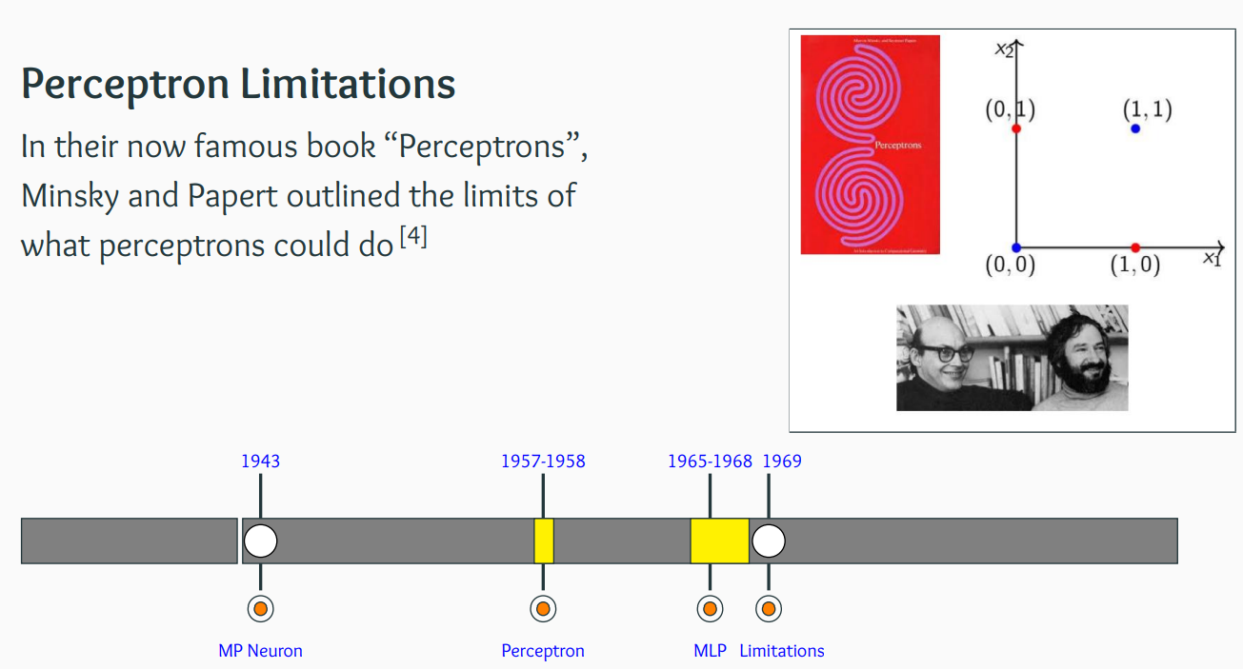
Biological Neuron to Artificial Neuron
Simple Function cant be solved

Slide 25
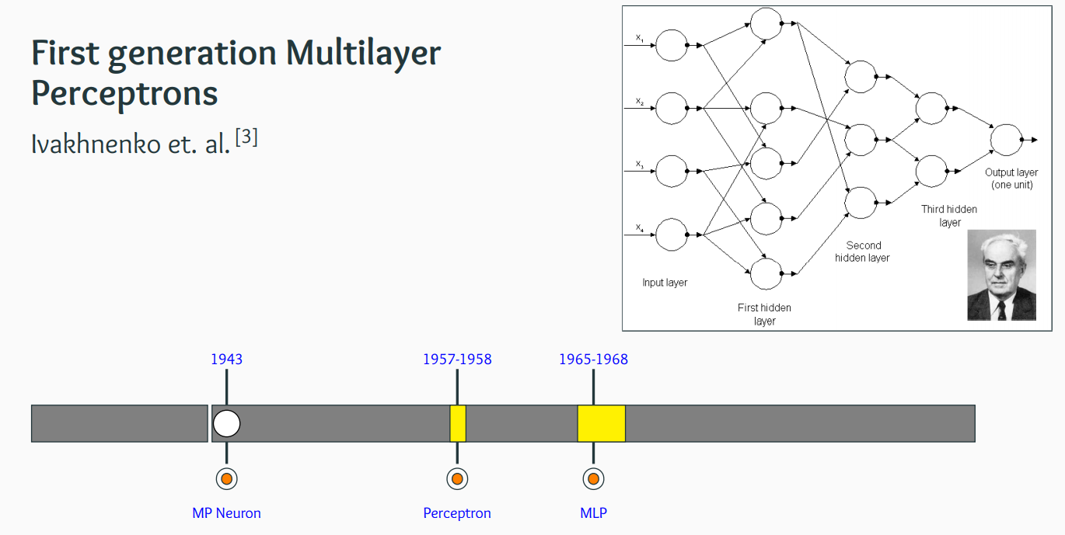
Biological Neuron to Artificial Neuron
Deep Learning – Deep Neural Networks

Slide 26
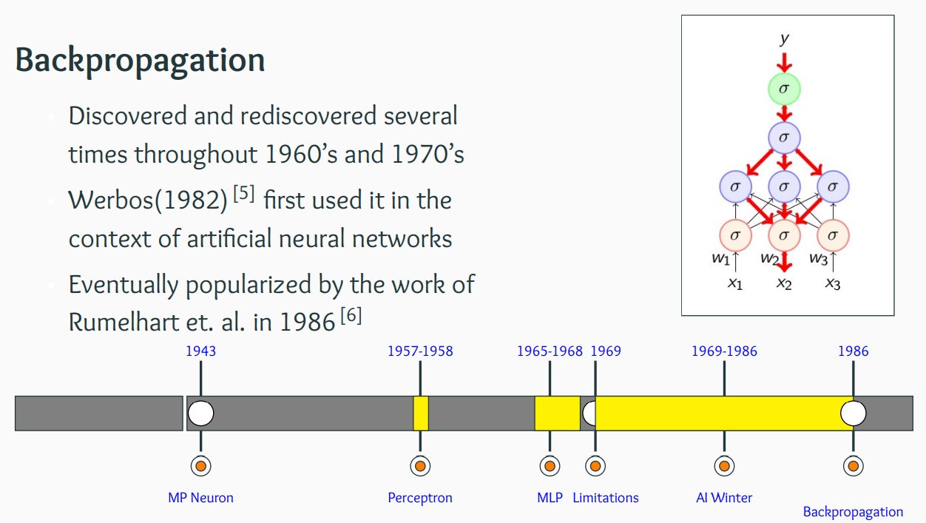
Biological Neuron to Artificial Neuron

Slide 27

History of Deep Learning - Deep Revival

Slide 28
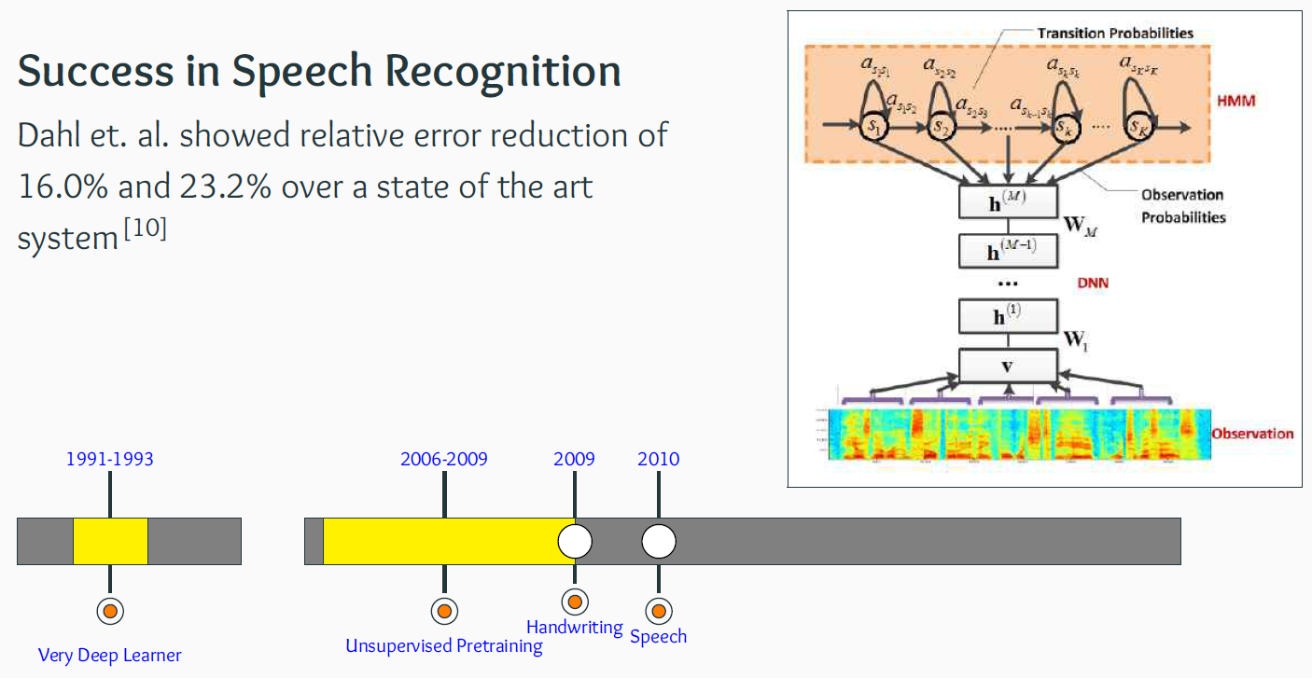
History of Deep Learning - Deep Revival

Slide 29
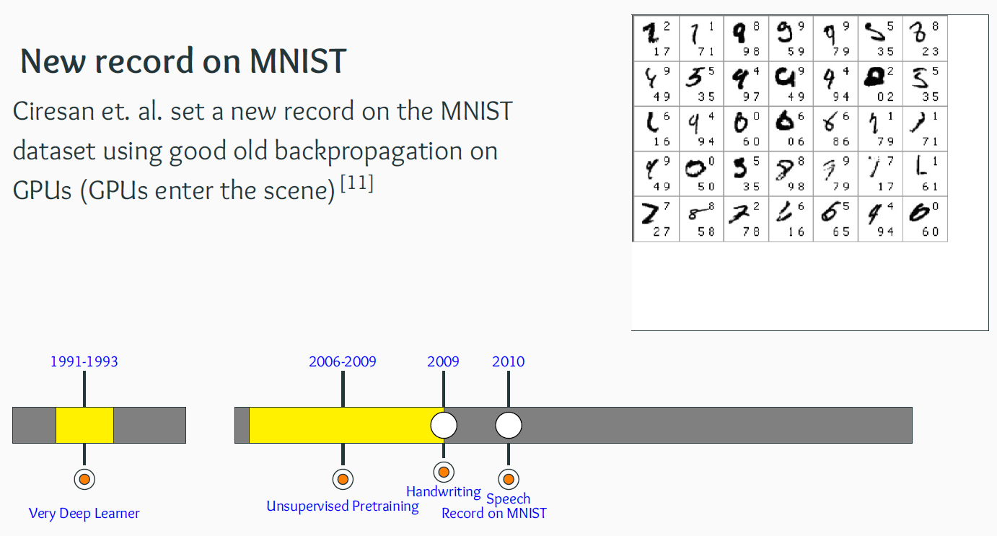
History of Deep Learning - Deep Revival

Slide 30
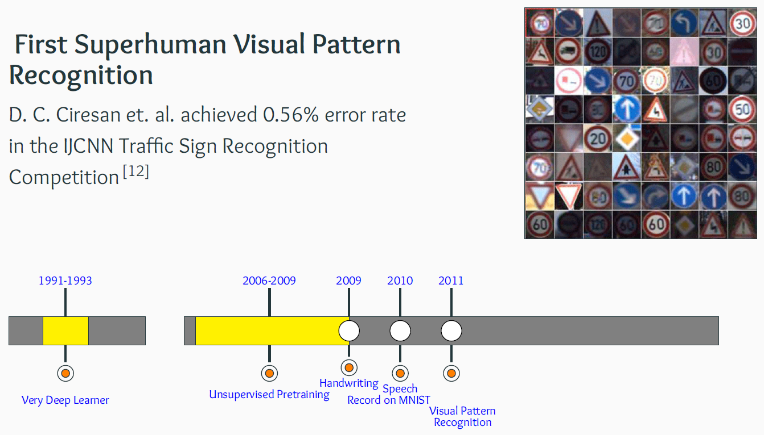
History of Deep Learning - Deep Revival

Slide 31
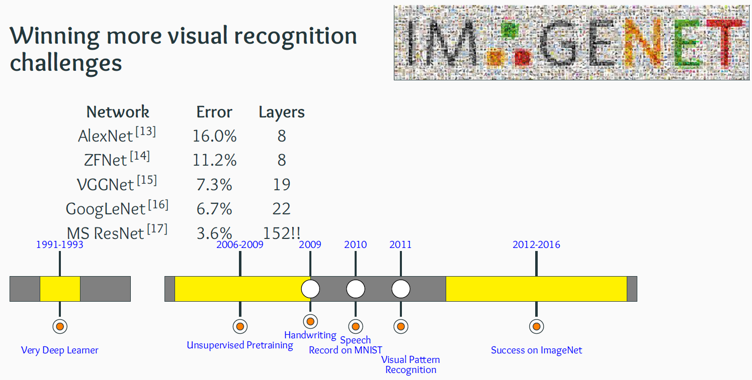
History of Deep Learning - Deep Revival

Slide 32
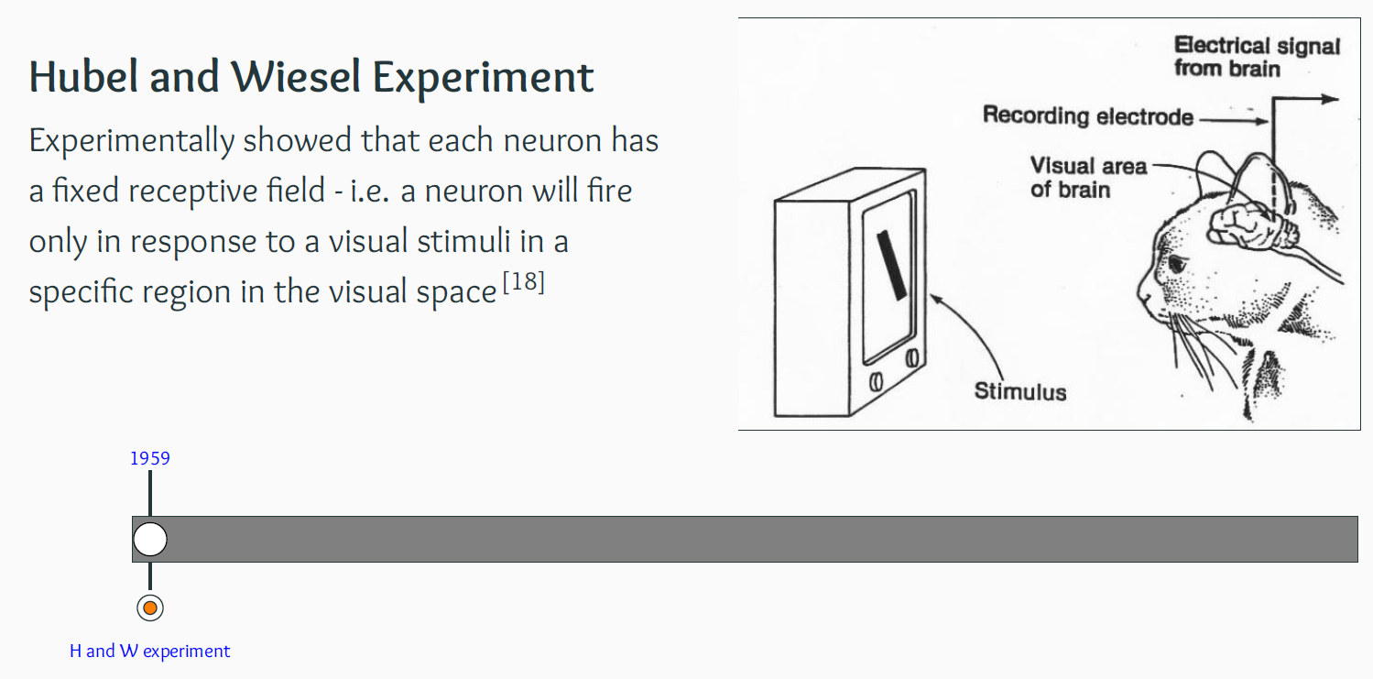
From Cats to Convolutional Neural Networks

Slide 33
Biological Neuron - McCulloch Pitts Neuron

Slide 34
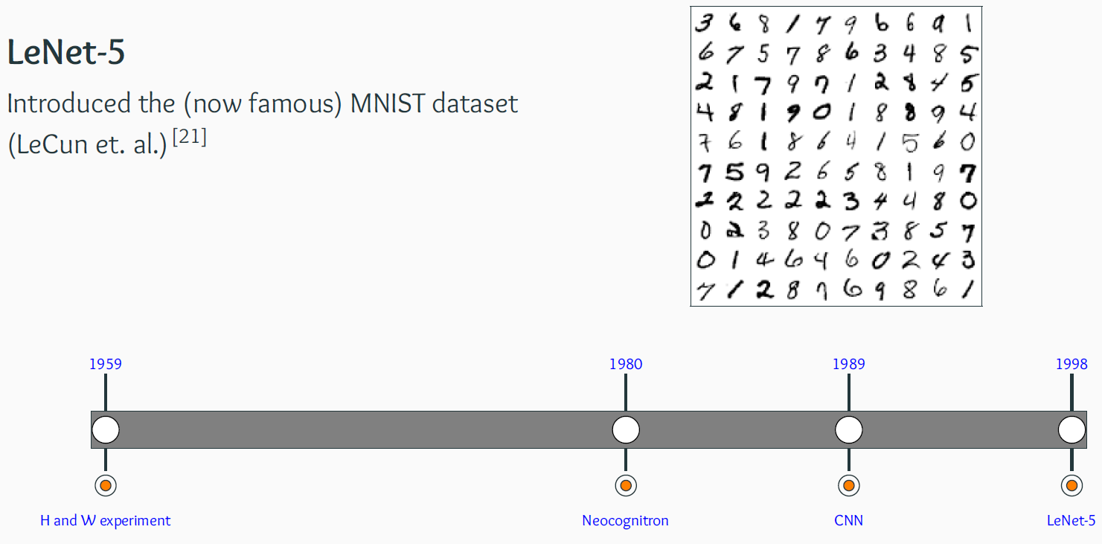
From Cats to Convolutional Neural Networks

Slide 35
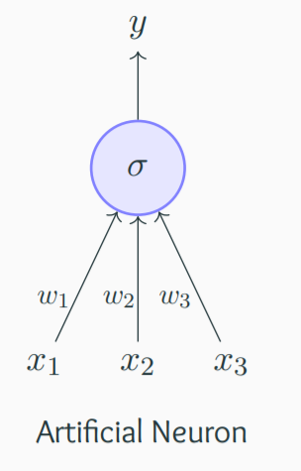
Artificial Neuron
The most fundamental unit of a deep neural network is called an artificial neuron
Why is it called a neuron ? Where does the inspiration come from ?
The inspiration comes from biology (more specifically, from the brain)
biological neurons = neural cells = neural processing units
Biological Neurons

Slide 36
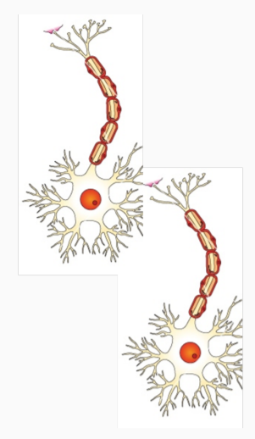
Artificial Neurons vs Biological Neurons

Slide 37
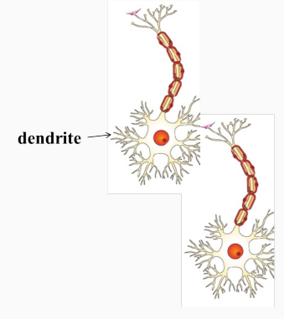
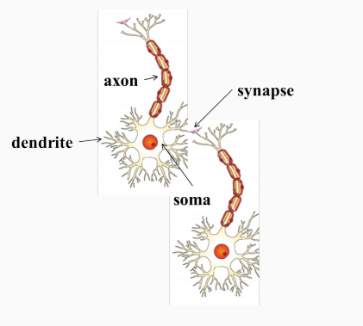
Artificial Neurons vs Biological Neurons
dendrite: receives signals from other neurons
synapse: point of connection to other neurons
soma: processes the information
axon: transmits the output of this
neuron

Slide 38

Cartoonish illustration - neuron works
Our sense organs interact with the outside world

Slide 39
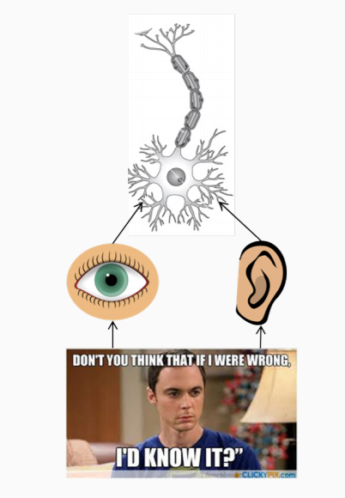
Cartoonish illustration - neuron works
Our sense organs interact with the outside world
They relay information to the neurons

Slide 40
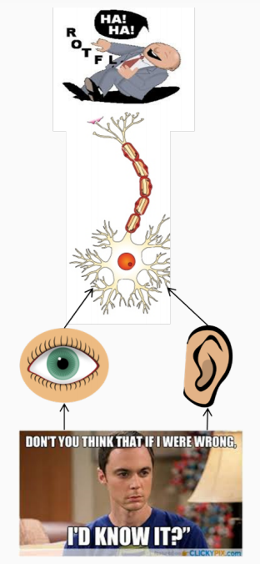
Cartoonish illustration - neuron works
Our sense organs interact with the outside world
They relay information to the neurons
The neurons (may) get activated and produces a response

Slide 41
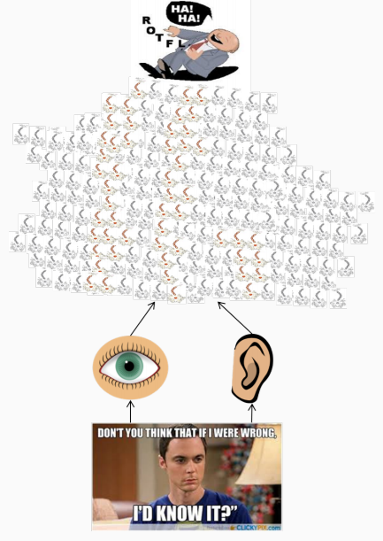
Cartoonish illustration - neuron works
Of course, in reality, it is not just a single neuron which does all this
There is a massively parallel interconnected network of neurons
The sense organs relay information to the lowest layer of neurons
Some of these neurons may fire (in red) in response to this information and in turn relay information to other neurons they are connected to
These neurons may also fire (again, in red) and
the process continues eventually resulting in a response (laughter in this case)
An average human brain has around 10¹¹ (100 billion) neurons!

Slide 42




Cartoonish illustration - neuron works
This massively parallel network also ensures that there is division of work
Each neuron may perform a certain role or respond to a certain stimulus

Slide 43
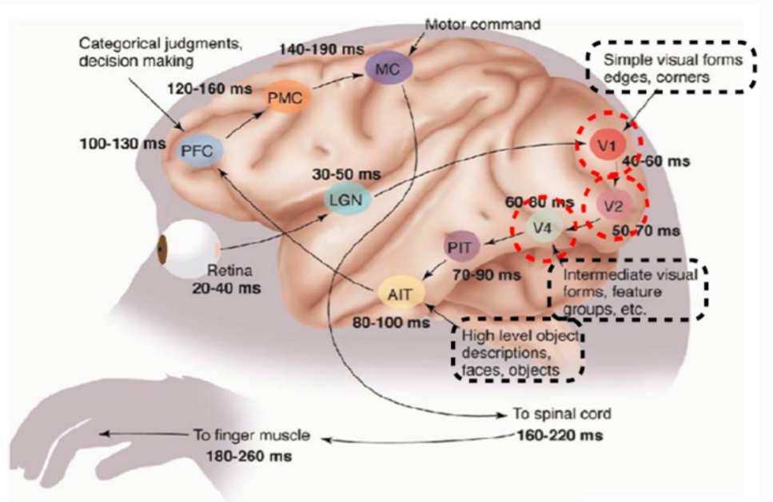
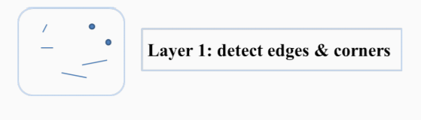
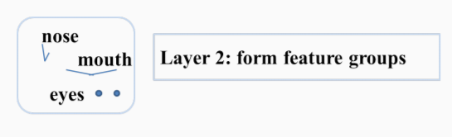
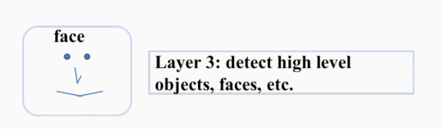
Simple illustration - processing visual information
observe that the layers V₁, V₂ to AIT form a hierarchy (from identifying simple visual forms to high level objects)
The neurons in the brain are arranged in a hierarchy

Slide 44
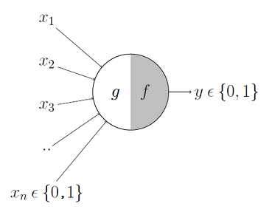
McCulloch Pitts Neuron
The first computational model of a neuron was proposed by Warren MuCulloch (neuroscientist) and Walter Pitts (logician) in 1943
It may be divided into 2 parts.
The first part, g takes an input (ahem dendrite ahem), performs an aggregation
Based on the aggregated value the second part, f makes a decision

Slide 45
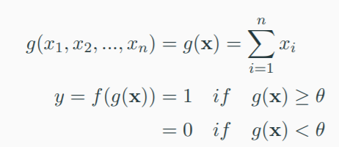
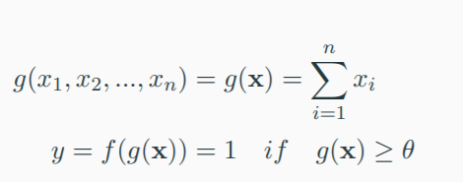
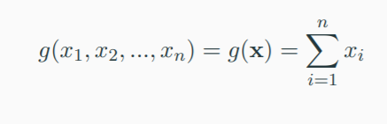
McCulloch Pitts Neuron
The inputs can be excitatory or inhibitory
y = 0 if any x_{i} is inhibitory , else (excitatory)
θ is called the thresholding parameter
This is called Thresholding Logic

Slide 46
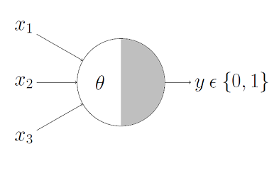
Boolean Functions Using M-P Neuron
This representation just denotes that, for the boolean inputs x_1, x_2 and x_3 if the g(x)
i.e., sum ≥ theta, the neuron will fire otherwise, it won’t

Slide 47
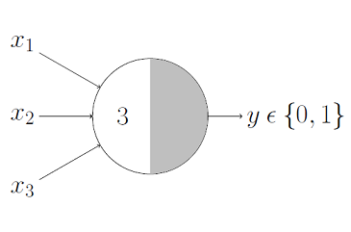
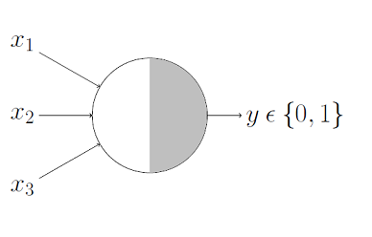
Boolean Functions Using M-P Neuron
An _____________neuron would only fire when ALL the inputs are ON i.e., g(x) ≥ 3 here

Slide 48
Boolean Functions Using M-P Neuron
An AND function neuron would only fire when ALL the inputs are ON i.e., g(x) ≥ 3 here

Slide 49

Boolean Functions Using M-P Neuron
An ___________neuron would fire if ANY of the inputs is ON i.e., g(x) ≥ 1 here

Slide 50
Boolean Functions Using M-P Neuron
An OR function neuron would fire if ANY of the inputs is ON i.e., g(x) ≥ 1 here

Slide 51
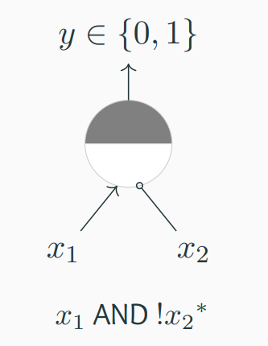
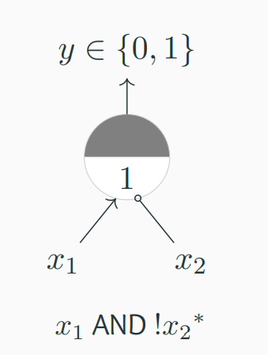
Boolean Functions Using M-P Neuron
∗ circle at the end indicates inhibitory input: if any inhibitory input is 1 the output will be 0

Slide 52
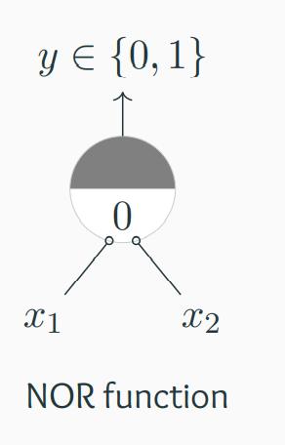
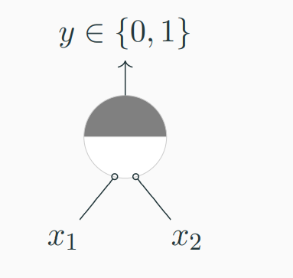
Boolean Functions Using M-P Neuron
Circle at the end indicates inhibitory input: if any inhibitory input is 1 the output will be 0

Slide 53
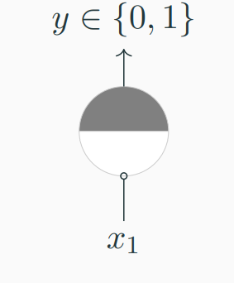
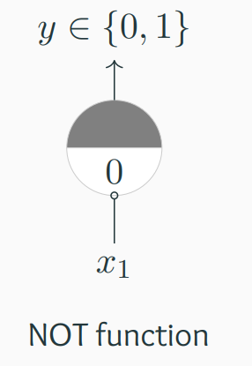
Boolean Functions Using M-P Neuron
Circle at the end indicates inhibitory input: if any inhibitory input is 1 the output will be 0

Slide 54
Boolean Functions Using M-P Neuron
Can any boolean function be represented using a McCulloch Pitts unit ?

Slide 55
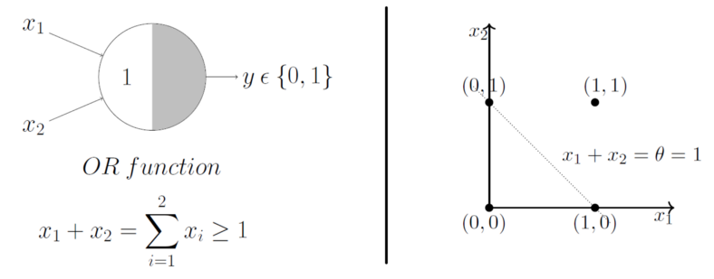
Geometric Interpretation of a MP Neuron
Already discussed that the OR function’s thresholding parameter theta is 1
Now plotting them on a 2D graph and making use of the OR function’s aggregation equation
x₁ + x₂ ≥ 1 using which we can draw the decision boundary as shown in the graph
Graphically show that all those inputs whose output when passed through the OR function M-P neuron lie ON or ABOVE that line and all the input points that lie BELOW that line are going to output 0
The M-P neuron just learnt a linear decision boundary ☺
The M-P neuron is splitting the input sets into two classes — positive and negative. Positive ones (which output 1) are those that lie ON or ABOVE the decision boundary and negative ones (which output 0) are those that lie BELOW the decision boundary

Slide 56
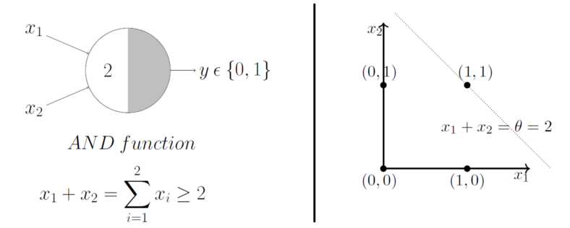
Geometric Interpretation of a MP Neuron

Slide 57
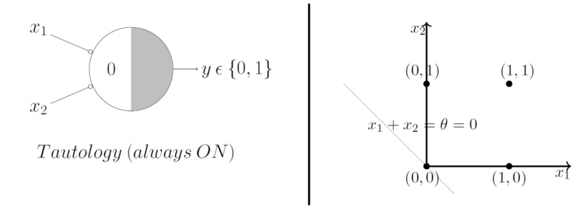
Geometric Interpretation of a MP Neuron
If you have more than 2 inputs?

Slide 58
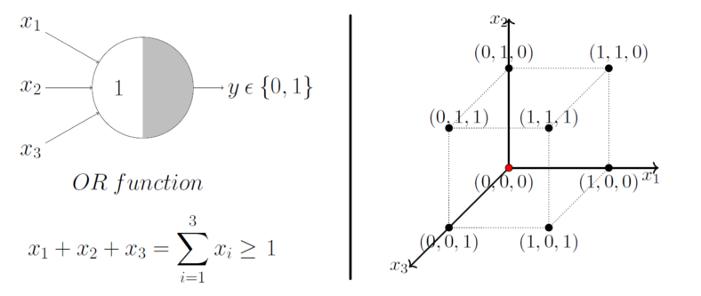

Geometric Interpretation of a MP Neuron
Lets just generalize this by looking at a 3 input OR function M-P unit. In this case, the possible inputs are 8 points — (0,0,0), (0,0,1), (0,1,0), (1,0,0), (1,0,1)……

Slide 59
Limitations of a MP Neuron
What about non-boolean (say, real) inputs?
Do we always need to hand code the threshold?
Are all inputs equal? What if we want to assign more importance to some inputs?
What about functions which are not linearly separable?
XOR function.

Slide 60
Classical Perceptron
Frank Rosenblatt, an American psychologist, proposed the classical perception model, the mighty artificial neuron, in 1958
It is more generalized computational model than the McCulloch-Pitts neuron where weights and thresholds can be learnt over time
A more general computational model than McCulloch–Pitts neurons
Main differences with MP Neuron:
Introduction of numerical weights for inputs and a mechanism for learning
these weights
Inputs are no longer limited to boolean values
Refined and carefully analysed by Minsky and Papert (1969) - their model is referred to as the perceptron model

Slide 61




Perceptron Model

Slide 62

Perceptron Model
Consider the task of predicting whether I would watch a random game of football on TV or not
Here, w₀ is called the bias because it represents
the prior
A football freak may have a very low threshold and may watch any football game irrespective of the league, club or importance of the game [theta = 0]
The point is, the weights and the bias will depend on the data ( viewing history in this case)
Based on the data, if needed the model may have to give a lot of importance (high weight) to the isManUnitedPlaying input and penalize the weights of other inputs
A selective viewer like me may only watch a football game that is a premier league game, featuring Man United game and is not friendly [theta = 2]

Slide 63

Perceptron vs McCulloch-Pitts Neuron
From the equations, it is clear that even a perceptron separates the input space into two halves, positive and negative
All the inputs that produce an output 1 lie on one side (positive half space) and all the inputs that produce an output 0 lie on the other side (negative half space)
A single perceptron can only be used to implement linearly separable functions, just like the M-P neuron
Then what is the difference? Why do we claim that the perceptron is an updated version of an M-P neuron?
The weights, including the threshold can be learned and the inputs can be real values

Slide 64



Boolean Functions Using Perceptron
One possible solution to this set of inequalities is w₀ = −1, w₁ = 1.1, , w₂ = 1.1
you can try it out for AND function

Slide 65




Errors and Error Surfaces
Let us fix the threshold (−w₀ = 1) and try different values of w1, w2
Say, w₁ = −1, w₂ = −1
w1 = 1.5, w2 = 0
w1 = .45, w2 = 0.45
We are interested in finding an algorithm which finds the values of w1, w2 which minimize this error ☺ ☺

Slide 67

Perceptron as a binary classifier
x₁ = isActorRajinikanth
x₂ = isGenreFamily
x₃ = isDirectorKSRavi
x₄ = imdbRating(scaled to 0 to 1)
... ...
x_{n} = criticsRating(scaled to 0 to 1)
Let us reconsider our problem of deciding whether to watch a movie or not
Suppose we are given a list of m movies and a label (class) associated with each movie indicating whether the user liked this movie or not : binary decision
Further, suppose we represent each movie with n features (some boolean, some real valued)
We will assume that the data is linearly separable and we want a perceptron to learn how to make this decision
In other words, we want the perceptron
to find the equation of this separating plane (or find the values of w₀, w₁, w₂, .., w_{m})

Slide 68
Perceptron Algorithm
Algorithm: Perceptron Learning Algorithm
P ← inputs with label 1;

Slide 69
Perceptron Algorithm
Algorithm: Perceptron Learning Algorithm
P ← inputs with label 1;
N ← inputs with label 0;

Slide 70
Perceptron Algorithm
Algorithm: Perceptron Learning Algorithm
P ← inputs with label 1;
N ← inputs with label 0;
Initialize w randomly;

Slide 71
Perceptron Algorithm
Algorithm: Perceptron Learning Algorithm
P ← inputs with label 1;
N ← inputs with label 0;
Initialize w randomly;
while !convergence do
end

Slide 72

Perceptron Algorithm

Slide 73

Perceptron Algorithm

Slide 74





Perceptron Algorithm
We are interested in finding the line
w^{T}x = 0 which divides the input space
into two halves
Every point (x) on this line satisfies the equation w^{T}x = 0
What can you tell about the angle (α) between w and any point (x) which lies
on this line ?

Slide 75



Perceptron Algorithm
Consider some points (vectors) which lie in the
positive half space of this line (i.e., w^{T}x ≥ 0)
What will be the angle between any such vector and w ?
Obviously, less than 90°
What about points (vectors) which lie in the negative half space of this line (i.e., w^{T}x < 0)
What will be the angle between any such vector and w ?
Obviously, greater than 90°

Slide 76

Perceptron Algorithm
For x ∈ P if w.x < 0 then it means
that the angle (α) between this x
and the current w is greater than
90° (but we want α to be less than
90°)
What happens to the new angle
(α_{new}) when w_{new} = w + x

Slide 77

Perceptron Algorithm
For x ∈ N if w.x ≥ 0 then it means that the angle (α) between this x and the current w is less than 90° (but we want α to be greater than 90°)
What happens to the new angle
(α_{new}) when w_{new} = w − x

Slide 78


Slide 79


Slide 80







Perceptron Algorithm
initializing w1, w2, as 1 and w0 as –1
initializing w1, w2, as 2 and w0 as –1

Slide 81
So far,
What about non-boolean (say, real) inputs?
Real valued inputs are allowed
No, we can learn the threshold
Do we always need to hand code the threshold?
Are all inputs equal? What if we want to assign more weight (importance) to some
inputs?
A perceptron allows weights to be assigned to inputs
What about functions which are not linearly separable ?
Not possible with a single perceptron but we will see how to handle this

Slide 82



what do we do about functions which are not linearly separable ?
The fourth condition contradicts conditions 2 and 3
Hence we cannot have a solution to this set of inequalities
XOR is not linearly separable using single layer perceptron
What about XNOR gate (sometimes ENOR, EXNOR or NXOR and pronounced as Exclusive NOR) ?

Slide 83


Example

Slide 84


Linearly Separable Boolean Functions
How many boolean functions can you design from 2 inputs ?
In general, how many Boolean functions can you have for n inputs ?

Slide 85



Representation Power of a Network of Perceptrons
The bias (w₀) of each perceptron is -2 (i.e.,
each perceptron will fire only if the weighted
sum of its input is ≥ 2)
Assume True = +1 and False = -1
Consider 2 inputs and 4 perceptrons
Each input is connected to all the 4 perceptrons with specific weight

Slide 86


Representation Power of a Network of Perceptrons
Each of these perceptrons is connected to an
output perceptron by weights (which need to
be learned)
The output of this perceptron (y) is the output of this network

Slide 87

Representation Power of a Network of Perceptrons
This network contains 3 layers
Terminology Alert !!!
The layer containing the inputs (x1, x2) is
called the input layer
The middle layer containing the 4 perceptrons
is called the hidden layer
The final layer containing one output neuron is called the output layer
The outputs of the 4 perceptrons in the hidden layer are denoted by h₁, h₂, h₃, h₄
The red and blue edges are called layer 1 weight
w₁, w₂, w₃, w₄ are called layer 2 weights

Slide 88


Representation Power of a Network of Perceptrons
Each perceptron in the middle layer fires only
for a specific input (and no two perceptrons
fire for the same input)
the first perceptron fires for {-1,-1}
the second perceptron fires for {-1,1}
the third perceptron fires for {1,-1}
the fourth perceptron fires for {1,1}

Slide 89



Example of the XOR function
This results in the following four conditions to implement XOR: w₁ < w₀, w₂ ≥ w₀, w₃ ≥w₀, w₄ < w₀
Unlike before, there are no contradictions now and the system of inequalities can be satisfied

Slide 90

What if we have more than 3 inputs ?
Again each of the 8 perceptorns will fire only for one of the 8 inputs
Each of the 8 weights in the second layer is responsible for one of the 8 inputs and can be adjusted to produce the desired output for that input
What if we have n inputs ?
Any boolean function of n inputs can be represented exactly by a network of perceptrons containing 1 hidden layer with 2^{n} perceptrons and one output layer containing 1 perceptron

Slide 91

Example
Given this data about our past movie experience
For each movie, we are given the values of the various factors (x1, x2, . . . , xn) that we base our decision on and we are also given the value of y (like/dislike)
p_{i} ’s are the points for which the output was 1 and n_{i} ’s are the points for which it was 0
The data may or may not be linearly separable
It is possible to have a network of perceptrons and learn the weights in this network such that for any given p_{i} or n_{j} the output of the network will be the same as y_{i} or y_{j} (i.e., we can separate the positive and the negative points)
Networks of the form that we just saw (containing, an input, output and one or more hidden layers) are called Multilayer Perceptrons (MLP, in short) /”Multilayered Network of Perceptrons”

Slide 92


Slide 93


Slide 94


Slide 95


Slide 96


Slide 97


Slide 98


Slide 99

Perceptrons to sigmoidal neurons
A perceptron will fire if the weighted sum of its inputs is greater than the threshold (-w₀)
For example, let us return to our problem of deciding whether we will like or dislike a movie?
Consider that we base our decision only on one input (x1 = criticsRating which lies between 0 and 1)
If the criticsRating = 0.51??
If the movie with criticsRating = 0.49 ??
The thresholding logic used by a perceptron is very harsh !

Slide 100


Perceptrons to sigmoidal neurons
This behaviour is not a characteristic of the specific problem we chose or the specific weight and threshold that we chose
It is a characteristic of the perceptron function itself which behaves like a step function
For most real world applications we would expect a smoother decision function which gradually changes from 0 to 1

Slide 101


Sigmoid neurons
Introducing sigmoid neurons where the output function is much smoother than the step function
no longer see a sharp transition around the
threshold -w₀
Also the output y is no longer binary but a real value between 0 and 1 which can be interpreted as a probability
Instead of a like/dislike decision we get the probability of liking the movie

Slide 102
Why do we use an activation function ?
If we do not have the activation function the weights and bias would simply do a linear transformation.
A linear equation is simple to solve but is limited in its capacity to solve complex problems and have less power to learn complex functional mappings from data.
A neural network without an activation function is just a linear regression model.
Neural networks use non-linear activation functions, which can help the network learn complex data, compute and learn almost any function representing a question, and provide accurate predictions

Slide 103


Slide 104


Slide 105


Slide 106
Why use a non-linear activation function?
Use a linear activation function or identity activation functions then the neural network will just output a linear function of input
No matter how many layers our neural network has, it will still behave just like a single layer network because summing these layers will give us another linear function which is not strong enough to model data
activation function should be differentiable

Slide 107


Sigmoid / Logistic
Sigmoid function gives an ‘S’ shaped curve. In order to map predicted values to probabilities, we use the sigmoid function. The function maps any real value into another value between 0 and 1
Advantages
The function is differentiable. That means, we can find the slope of the sigmoid curve at any two points.
Output values bound between 0 and 1, normalizing the output of each neuron.
Disadvantages
Vanishing gradient — for very high or very low values of X, there is almost no change to the prediction, causing a vanishing gradient problem.
Due to vanishing gradient problem, sigmoids have slow convergence.
Outputs not zero centered.
Computationally expensive.

Slide 108


Tan-h / Hyperbolic tangent
Zero centered — making it easier to model inputs that have strongly negative, neutral, and strongly positive values.
The function and its derivative both are monotonic.
Works better than sigmoid function
It also suffers vanishing gradient problem and hence slow convergence.

Slide 109


Slide 110


ReLU (Rectified Linear Unit)
Computationally efficient — allows the network to converge very quickly
Non-linear — although it looks like a linear function, ReLU has a derivative function and allows for back-propagation
The Dying ReLU problem — when inputs approach zero, or are negative, the gradient of the function becomes zero, the network cannot perform back-propagation and cannot learn.
Dead Neuron Problem

Slide 111


Leaky ReLU
Prevents dying ReLU problem — this variation of ReLU has a small positive slope in the negative area, so it does enable back-propagation, even for negative input values
Results not consistent — leaky ReLU does not provide consistent predictions for negative input values.
Instead of multiplying x with a constant term we can multiply it with a hyper-parameter which seems to work better the leaky ReLU.
This extension to leaky ReLU is known as Parametric ReLU.

Slide 112


Slide 113



Example of Feed Forward Neural Network
z is the weighted input
b is bias
y is the output
σ(z) is the activation function which represents sigmoid function
x1, x2 are the inputs. w1, w2 are the coefficient weights for each input

Slide 114






Binary Classification of a Picture Using 1 Unit
let’s say we put the following picture as input
the weights are set as random (0 to 1 value) and the bias is set as 0
the inputs of the input layer, that is, the inputs of the hidden layer would be as follows

Slide 115


Binary Classification of a Picture Using 1 Unit
calculate using all of the units of the neural network, and calculate the final output of the whole network

Slide 116


Binary Classification of a Picture Using 1 Unit
calculate using all of the units of the neural network, and calculate the final output of the whole network
initialize the weights with random values (0~1) and the bias as 0

Slide 117



Binary Classification of a Picture Using 1 Unit
calculate using all of the units of the neural network, and calculate the final output of the whole network
Input layer → Hidden layer

Slide 118





Binary Classification of a Picture Using 1 Unit
calculate using all of the units of the neural network, and calculate the final output of the whole network
Hidden layer → Output layer
In the other words, the parameters were aimlessly set up in the first place and happen to give an accurate result. When learning with neural network, the neural network adjust its own parameters to give a better accurate classification result. To do this, an algorithm called "Backpropagation" is used to calculate how much update is needed for each weight
It is y≥0.5 , thus y is close to 1. This means The number on the picture is 1.

Slide 119

Overall picture

Slide 120



What is the derivative of the logistic sigmoid function?

Slide 121




Backpropagation Example
The Forward Pass
the neural network currently predicts given the weights and biases above and inputs of 0.05 and 0.10.
To do this we’ll feed those inputs forward though the network
To figure out the total net input to each hidden layer neuron, squash the total net input using an activation function (use the logistic function), then repeat the process with the output layer neurons

Slide 122

Backpropagation Example
Basic structure
Use a neural network with two inputs, two hidden neurons, two output neurons. Additionally, the hidden and output neurons will include a bias.
Goal of backpropagation is to optimize the weights so that the neural network can learn how to correctly map arbitrary inputs to outputs
initial weights, the biases
Example : a single training set: given inputs 0.05 and 0.10, we want the neural network to output 0.01 and 0.99

Slide 123



Backpropagation Example
The Forward Pass
Calculating the Total Error
Target output for o1 is 0.01 but the neural network output 0.75136507 🡪 error is
Repeating this process for o2 (remembering that the target is 0.99)
Total error for the neural network is the sum of these errors

Slide 124



Backpropagation Example
The Backwards Pass
Our goal with backpropagation is to update each of the weights in the network so that they cause the actual output to be closer the target output, thereby minimizing the error for each output neuron and the network as a whole
Output Layer
Consider w₅, want to know how much a change in w₅ affects the total error,
By applying the chain rule

Slide 125


Backpropagation Example
The Backwards Pass
Output Layer
First, how much does the total error change with respect to the output?

Slide 126


Backpropagation Example
The Backwards Pass
Output Layer
how much does the output of o1 change with respect to its total net input?

Slide 127






Backpropagation Example
The Backwards Pass
Output Layer
Finally, how much does the total net input of o1 change with respect to w₅?
Update the error
the actual updates in the neural network after we have the new weights leading into the hidden layer neurons

Slide 128





Backpropagation Example
Hidden Layer
continue the backwards pass by calculating new values for w₁, w₂, w₃, and w₄
similar process as we did for the output layer, but slightly different to account for the fact that the output of each hidden layer neuron contributes to the output (and therefore error) of multiple output neurons
out_{h1} affects both out_{o1} and out_{o2}

Slide 129






Backpropagation Example
Hidden Layer
continue the backwards pass by calculating new values for w₁, w₂, w₃, and w₄

Slide 130




Backpropagation Example
Hidden Layer
continue the backwards pass by calculating new values for w₁, w₂, w₃, and w₄
calculate the partial derivative of the total net input to h1 with respect to w₁

Slide 131




Backpropagation Example
Hidden Layer
continue the backwards pass by calculating new values for w₁, w₂, w₃, and w₄
Repeating this for w₂, w₃, and w₄

Slide 132
Backpropagation Example
updated all of our weights!
fed forward the 0.05 and 0.1 inputs originally, the error on the network was 0.298371109
After this first round of backpropagation, the total error is now down to_________________ ☺
But after repeating this process 10,000 times, for example, the error plummets to 0.0000351085. At this point, when we feed forward 0.05 and 0.1, the two outputs neurons generate 0.015912196 (vs 0.01 target) and 0.984065734 (vs 0.99 target)

Slide 133




Vanishing Gradient Problem
The decrease of the backpropagated error signal (often exponentially) with the increasing distance from the final layer (typically the output layer) is the problem pointing to Vanishing Gradient Descent.
The values of W6 depend on the value of W4 and W5
The values of W4 (and W5) in turn depend on the value of W1, W2, and W3.
As we go down the layers, the derivative decreased, so the value of (𝕕W6/𝕕W4) is greater than (𝕕W4/𝕕W1).

Slide 134


Vanishing Gradient Problem
The problem of vanishing gradient descent typically occurs when the activation function is sigmoidal
This is because the value of the derivative of a sigmoid function always lies between 0 and 0.25
if the value of (𝕕W6/𝕕W4) is 0.1 and the value of (𝕕W4/𝕕W1) is 0.001, then the value of (𝕕W/𝕕W1) will be 0.0001
You can clearly see, that as we will increase the layers in our network, the value of (𝕕W/𝕕W1) would further decrease, and therefore, no significant change in the value of the weights. This is known as the Vanishing Gradient Problem

Slide 135



Weight Initialization
A uniform distribution draws a random value from the range [lower, upper] where every value inside this range has equal probability of being drawn.
64 inputs and 32 outputs
Executing the code above NumPy will randomly generate 64×32 = 2,048 values from the range [−0.05, 0.05], where each value in this range has equal probability
A normal distribution where we define the probability density for the Gaussian distribution as
When using the Keras library the RandomNormal class draws random values from a normal distribution with µ = 0 and σ = 0.05

Slide 136



Weight Initialization
Glorot/Xavier Uniform and Normal
Here, the authors define a parameter Fin (called “fan in,” or the number of inputs to the layer) along with Fout (the “fan out,” or number of outputs from the layer)
normal distribution
For the normal distribution the limit value is constructed by averaging the Fin and Fout together and then taking the square-root. A zero-center (µ = 0) is then used
uniform distribution

Slide 137




Weight Initialization
He initialization
uniform distribution
normal distribution
When to use which weight Initialization??

Slide 138

Stochastic Gradient Descent (SGD)
Problem with Gradient Descent
you can see from the partial derivative equations that for a single update of each parameter, we go over N data points (summation i=0 to N).
Suppose you are working with a dataset which involves thousands of features and millions of data points then for each update to the parameter we would have thousand of derivatives and for each derivative, we would have millions of terms.
That would be around a billion calculations for each step, which is computationally very very expensive.
It will really slow down the process

Slide 139
Stochastic Gradient Descent (SGD)
Problem with Gradient Descent
you can see from the partial derivative equations that for a single update of each parameter, we go over N data points (summation i=0 to N).
Suppose you are working with a dataset which involves thousands of features and millions of data points then for each update to the parameter we would have thousand of derivatives and for each derivative, we would have millions of terms.
That would be around a billion calculations for each step, which is computationally very very expensive.
It will really slow down the process

Slide 140


Slide 141


Slide 142


Slide 143


Slide 144


Slide 145


Slide 146


Slide 147


Slide 148


Slide 149


Slide 150


Slide 151


Slide 152



Slide 153

Gradient Descent with Momentum
Gradient descent with momentum will always work much faster than the algorithm Standard Gradient Descent.
The basic idea of Gradient Descent with momentum is to calculate the exponentially moving (weighted) average of your gradients and then use that gradient instead to update your weights.
It functions faster than the regular algorithm for the gradient descent

Slide 154

Nesterov Accelerated Gradient (NAG)
In figure (a), update 1 is positive i.e., the gradient is negative because as w_0 increases L decreases.
Even update 2 is positive as well and you can see that the update is slightly larger than update 1, thanks to momentum.
By now, you should be convinced that update 3 will be bigger than both update 1 and 2 simply because of momentum and the positive update history.
Update 4 is where things get interesting.
In vanilla momentum case, due to the positive history, the update overshoots and the descent recovers by doing negative updates.

Slide 155


Nesterov Accelerated Gradient (NAG)
But in NAG’s case, every update happens in two steps — first, a partial update, where we get to the look_ahead point and then the final update
First 3 updates of NAG are pretty similar to the momentum-based method as both the updates (partial and final) are positive in those cases.
As usual, each update happens in two stages, the partial update (4a) is positive, but the final update (4b) would be negative as the calculated gradient at w_lookahead would be negative
This negative final update slightly reduces the overall magnitude of the update, still resulting in an overshoot but a smaller one when compared to the vanilla momentum-based gradient descent

Slide 156


Gradient Descent with RMSProp
RProp
RProp, or we call Resilient Back Propagation, is the widely used algorithm for supervised learning with multi-layered feed-forward networks
backpropagation
The error function can be presented by performing a simple gradient descent

Slide 157

Gradient Descent with RMSProp
The choice of the learning rate ɛ, which scales the derivative, has an important effect on the time needed until convergence is reached.
If it is set too small, too many steps are needed to reach an acceptable solution; on the contrary, a large learning rate will possibly lead to oscillation, preventing the error to fall below a certain value
RProp can combine the method with momentum method, to prevent above problem

Slide 158


Gradient Descent with RMSProp
RMSProp (Root Mean Squared Propagation) keep moving average of the squared gradients for each weight.
And then we divide the gradient by square root the mean square.

Slide 159

Gradient Descent with RMSProp
Refer the excel sheet – RMSProp.xlsx

Slide 160


Slide 161
References
https://medium.datadriveninvestor.com/artificial-intelligence-vs-robotics-vs-machine-learning-vs-deep-learning-vs-data-science-70ff828cdf39
https://ai.plainenglish.io/data-science-vs-artificial-intelligence-vs-machine-learning-vs-deep-learning-50d3718d51e5?gi=232c483101e2
11-785 Deep Learning (cmu.edu)

Slide 162
Thanks

